Slide 1
Chapter One: Introduction
A Short Introduction to Hardware, Software, and Algorithm development

Slide 2
Chapter Goals
In this chapter you will earn:
About computer hardware, software and programming
How to write and execute your first Python program
How to diagnose and fix programming errors
How to use pseudocode to describe an algorithm

Slide 3
Our First Definition
Algorithm:
An algorithm is a step by step description of how to solve a problem

Slide 4
Computer Programs
A computer program tells a computer the sequence of steps needed to complete a specific task
The program consists of a very large number of primitive (simple) instructions
Computers can carry out a wide range of tasks because they can execute different programs
Each program is designed to direct the computer to work on a specific task
Programming:
The act of designing, implementing, and testing computer programs

Slide 5
Hardware and Software
The building blocks that make up a computer

Slide 6
Hardware
Hardware consists of the physical elements in a computer system.
Some very visible examples are the monitor, the mouse, external storage, and the keyboard.
The central processing unit (CPU) performs program control and data processing
Storage devices include memory (RAM) and secondary storage
Hard disk
Flash drives
CD/DVD drives
Input / output devices allow the user to interact with the computer
Mouse, keyboard, printer, screen…

Slide 7
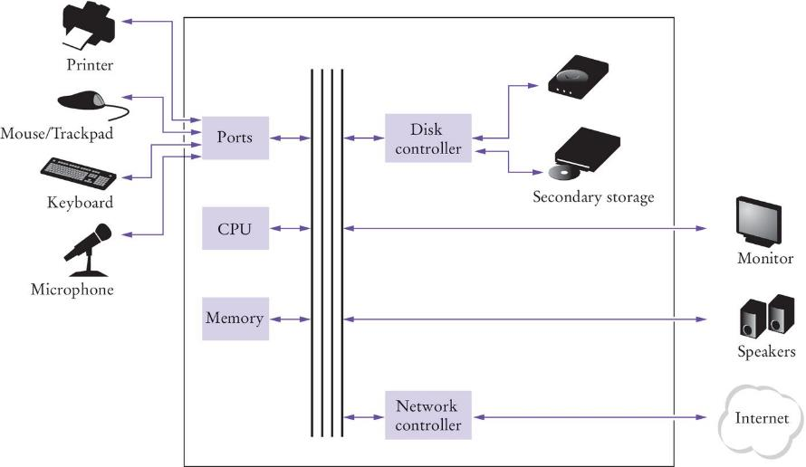
Simple View of a Computer’s Components

Slide 8
The CPU
The CPU has two components, the control unit and the arithmetic logic unit
The control unit directs operation of the processor.
All computer resources are managed by the control unit.
It controls communication and co-ordination between input/output devices.
It reads and interprets instructions and determines the sequence for processing the data.
It provides timing and control signals
The the arithmetic logic unit contains the circuitry to perform calculations and do comparisons.
It is the workhorse portion of the computer and its job is to do precisely what the control unit tells it to do.

Slide 9
Storage
There are two types of storage:
Primary Storage
Secondary Storage
Primary storage is composed of memory chips: electronic circuits that can store data as long as it is provided electric power
Secondary storage provides a slower, less expensive storage that is persistent: the data persists without electric power
Computers store both data and programs
The data and program are located in secondary storage and loaded into memory when the program is executed

Slide 10
Memory
A simple way to envision primary memory is a table of cells all the same size, one byte, and each containing a unique address beginning with 0.
The “typical” computer has a main memory ranging from 4 gigabytes (GB), to 32 GB.
How big is a gigabyte?
A byte is 8 bits.
A kilobyte, KB, is 1024 bytes, or “about 1 thousand bytes.”
A megabyte, MB, is 1,048,576 bytes, or “about 1 million bytes.”
A gigabyte, GB, is 1,073,741,824 bytes or “about 1 billion bytes.”
Notes:
Remember BINAC had a 512 WORD (31 bits per word) main memory

Slide 11
Executing a Program
Program instructions and data (such as text, numbers, audio, or video) are stored in digital format
When a program is started, it is brought into memory, where the CPU can read it.
The CPU runs the program one instruction at a time.
The program may react to user input.
The instructions and user input guide the program execution
The CPU reads data (including user input), modifies it, and writes it back to memory, the screen, or secondary storage.

Slide 12
Software
Software is typically realized as an application program
Microsoft Word is an example of software
Computer Games are software
Operating systems and device drivers are also software
Software
Software is a sequence of instructions and decisions implemented in some language and translated to a form that can be executed or run on the computer.
Computers execute very basic instructions in rapid succession
The basic instructions can be grouped together to perform complex tasks
Programming is the act of designing and implementing computer programs

Slide 13
Algorithms

Slide 14
Introduction to Algorithms
If you want a computer to perform a task, you start by writing an algorithm
An Algorithm is:
a sequence (the order mattering) of actions to take to accomplish the given task
An algorithm is like a recipe; it is a set of instructions written in a sequence that achieves a goal
For complex problems software developers write an algorithm before they attempt to write a computer program
For this class we will ALWAYS write an algorithm for each project
Developing algorithms is a fundamental problem solving skill
It has uses in many fields outside of Computer Science

Slide 15
Algorithm: Formal Definition
An algorithm describes a sequence of steps that is:
Unambiguous
No “assumptions” are required to execute the algorithm
The algorithm uses precise instructions
Executable
The algorithm can be carried out in practice
Terminating
The algorithm will eventually come to an end, or halt

Slide 16
Problem Solving: Algorithm Design
Algorithms are simply plans
Detailed plans that describe the steps to solve a specific problem
You already know quite a few
Calculate the area of a circle
Find the length of the hypotenuse of a triangle
Some problems are more complex and require more steps
Calculate PI to 100 decimal places
Calculate the trajectory of a missile

Slide 17
A Simple Example
A simple algorithm to get yourself a drink of orange juice
For simplicity, the following are true:
You have a clean glass in the cabinet
You have orange juice in your refrigerator
So one valid algorithm is:
get a glass from your cabinet
go to the refrigerator and get the orange juice container
open the orange juice container
pour the orange juice from the container into the glass
put the orange juice container back in the refrigerator
drink your juice
Notes:
This is one of several valid algorithms
As you will learn later, some algorithms are more efficient (and better) than others

Slide 18
Second Example: Selecting a Car
Problem Statement:
You have the choice of buying two cars.
One is more fuel efficient than the other, but also more expensive.
You know the price and fuel efficiency (in miles per gallon, mpg) of both cars.
You plan to keep the car for ten years.
Which car is the better deal?

Slide 19
Developing the Algorithm
Determine the inputs and outputs
From the problem statement we know:
Car 1: Purchase price, Fuel Efficiency
Car 2: Purchase price, Fuel Efficiency
Price per gallon = $4.00
Annual miles driven= 15,000
Length of time = 10 years
For each car we need to calculate:
Annual fuel consumed for each car
Annual fuel cost for each car
Operating cost for each car
Total cost of each Car
Then we select the car with the lowest total cost

Slide 20
Translating the Algorithm to pseudocode
Break down the problem into smaller tasks
‘Calculate total cost’ for each car
To calculate the total cost for each year we need to calculate the operating cost
The operating cost depends on the annual fuel cost
The annual fuel cost is the price per gallon * the annual fuel consumed
The annual fuel consumed is the annual miles drive / fuel efficiency
Describe each subtask as pseudocode
total cost = purchase price + operating cost

Slide 21
The Psuedocode
For each Car, compute the total cost
Annual fuel consumed = annual miles driven / fuel efficiency
Annual fuel cost = price per gallon * annual fuel consumed
Operating cost = Length of time * annual fuel cost
Total cost = purchase price + operating cost
If total cost1 < total cost2
Chose Car1
Else
Choose Car2

Slide 22
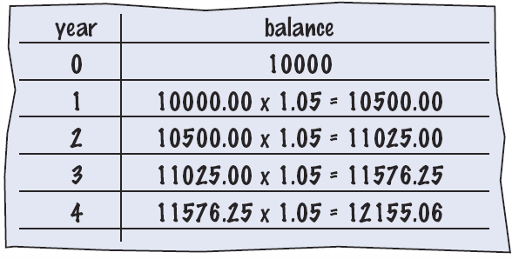
Bank Account Example
Problem Statement:
You put $10,000 into a bank account that earns 5 percent interest per year. How many years does it take for the account balance to be double the original?
How would you solve it?
Manual method
Make a table
Add lines until done
Use a spreadsheet!
Write a formula
Per line, based on line above

Slide 23
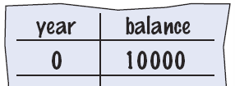
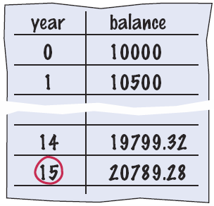
Develop the algorithm steps
You put $10,000 into a bank account that earns 5 percent interest per year. How many years does it take for the account balance to be double the original?
Break it into steps
Start with a year value of 0 and a balance of $10,000
Repeat the following while the balance is less than $20,000
Add 1 to the year value
Multiply the balance by 1.05
(5% increase)
Report the final year value as the answer

Slide 24
Translate to pseudocode
Pseudocode
Half-way between natural language and a programming language
Modified Steps
Set the year value of 0
Set the balance to $10,000
While the balance is less than $20,000
Add 1 to the year value
Multiply the balance by 1.05
Report the final year value as the answer
The pseudocode is easily translated into Python

Slide 25
The Python Language
In the early 1990’s, Guido van Rossum designed what would become the Python programming language
Van Rossum was dissatisfied with the languages available
They were optimized to write large programs that executed quickly
He needed a language that could not only be used to create programs quickly but also make them easy to modify
It was designed to have a much simpler and cleaner syntax than other popular languages such as Java, C and C++ (making it easier to learn)
Python is interpreted, making it easier to develop and test short programs
Python programs are executed by the Python interpreter
The interpreter reads your program and executes it

Slide 26
Programming Environments
There are several ways of creating a computer program
Using an Integrated Development Environment (IDE)
Using a text editor
You should use the method you are most comfortable with.
I’ll use the Wing IDE for all my in-class examples

Slide 27
IDE components
The source code editor can help programming by:
Listing line numbers of code
Color lines of code (comments, text…)
Auto-indent source code
Output window
Debugger

Slide 28
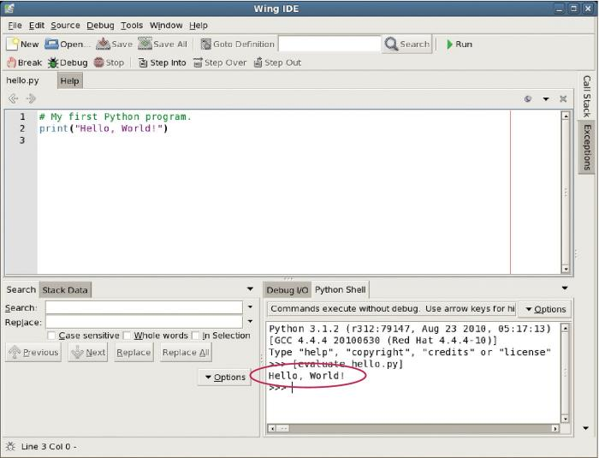
The Wing IDE
Editor
Output

Slide 29
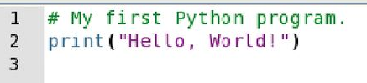
Your first program
Traditional ‘Hello World’ program in Python
We will examine this program in the next section
Typing the program into your IDE would be good practice!
Be careful of spelling e.g., ‘print’ vs. ‘primt’
PyTHon iS CaSe SeNsItiVe.

Slide 30
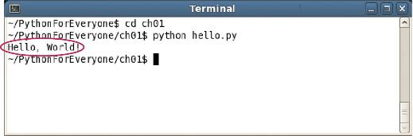
Text editor programming
You can also use a simple text editor to write your source code
Once saved as Hello.py, you can use a console window to:
Compile the program
Run the program
Compile/execute
Output

Slide 31
Organize your work
Your ‘source code’ is stored in .py files
Create a folder for this course
Create one folder per program inside the course folder
A program can consist of several .py files
Be sure you know where your IDE stores your files
You need to be able to find you files
Backup your files:
To a USB flash drive
To a network drive

Slide 32
Python interactive mode
Like other languages you can write/save a complete Python program in a file and let the interpreter execute the instructions all at once.
Alternatively you can run instructions one at a time using interactive mode.
It allows quick ‘test programs’ to be written.
Interactive mode allows you to write python statements directly in the console window

Slide 33
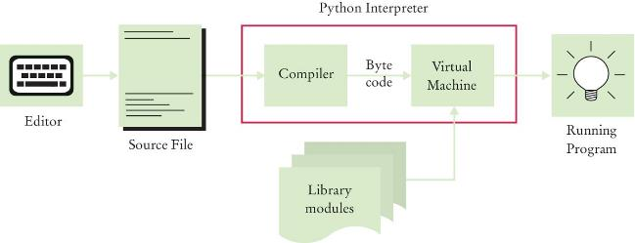
Source Code to a Running Program
The compiler reads your program and generates byte code instructions (simple instructions for the Python Virtual machine)
The Python Virtual machine is a program that is similar to the CPU of your computer
Any necessary libraries (e.g. for drawing graphics) are automatically located and included by the virtual machine

Slide 34
Let’s Get Started!
Open the Wing IDE on you lab computer
We are going to start simple, and as we learn more about Python, we’ll use additional features in Wing

Slide 35
The Wing IDE

Slide 36
The Wing Tool Bar
In the spirit of keeping things simple we will start with the four icons in the top left corner
If you don’t see the tool bar press “Shift” and “F2”
Create a new file
Open a file from disk
Save the active file
Save all unsaved items

Slide 37
Writing Our First Program
Click on the icon to create a new file
The File Editor window will open

Slide 38
“Hello World”
Type the following into the Editor:
# My first Python program
print(“Hello World!”)
Save your file as “hello.py”
This is “Step Two Write a simple program” from page 7 in your text.
Remember – Python is case sensitive
You have to enter the upper and lower case letters exactly as this appear above

Slide 39
Read to Run

Slide 40
Running your Program
Click the Green Arrow in the Tool Bar

Slide 41
Analyzing Your First Program
A Python program contains one or more lines of instructions (statements) that will be translated and executed by the interpreter
# My first Python program
Print(“Hello World!”)
The first line is a comment (a statement that provides descriptive information about the program to programmers).
The second line contains a statement that prints a line of text onscreen “Hello, World!”

Slide 42
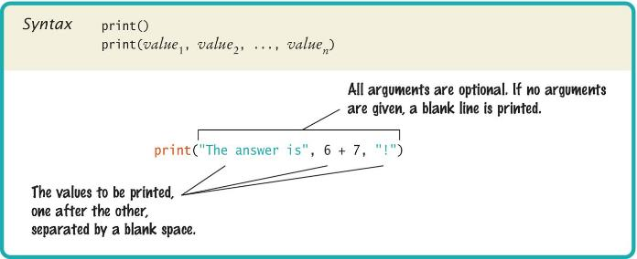
Basic Python Syntax: Print
Using the Python ‘print()’ function.
A function is a collection of programming instructions that carry out a particular task (in this case to print a value onscreen).
It’s code that somebody else wrote for you!

Slide 43
Syntax for Python Functions
To use, or call, a function in Python you need to specify:
The name of the function that you want to use (in the previous example the name was print)
Any values (arguments) needed by the function to carry out its task (in this case, “Hello World!”).
Arguments are enclosed in parentheses and multiple arguments are separated with commas.
A sequence of characters enclosed in quotations marks are called a string

Slide 44
More Examples of the print Function
Printing numerical values
print(3 + 4)
Evaluates the expression 3 + 4 and displays 7
Passing multiple values to the function
print(“the answer is”, 6 * 7)
Displays The answer is 42
Each value passed to the function is displayed, one after another, with a blank space after each value
By default the print function starts a new line after its arguments are printed
print(“Hello”)
print(“World!”)
Prints two lines of text
Hello
World!

Slide 45
Our Second Program (Page 12, printtest.py)
##
# Sample Program that demonstrates the print function
#
# Prints 7
print(3 + 4)
# Print Hello World! on two lines
print(“Hello”)
print(“World!”)
# Print multiple values with a single print function call
print(“My favorite number are”, 3 + 4, “and” 3 + 10)
# Print Hello World! on two lines
print(“Goodbye”)
print()
print(“Hope to see you again”)

Slide 46
Errors
There are two Categories of Errors:
Compile-time Errors
aka Syntax Errors
Spelling, capitalization, punctuation
Ordering of statements, matching of parenthesis, quotes…
No executable program is created by the compiler
Correct first error listed, then compile again.
Repeat until all errors are fixed
Run-time Errors
aka Logic Errors
The program runs, but produces unintended results
The program may ‘crash’

Slide 47
Syntax Errors
Syntax error are caught by the compiler
What happens if you
Miss-capitalize a word: Print("Hello World!")
Leave out quotes print(Hello World!)
Mismatch quotes print("Hello World!')
Don’t match brackets print('Hello'
Type each example above in the Wing Python Shell window
What error messages are generated?

Slide 48
Logic Errors
What happens if you
Divide by zero print(1/0)
Misspell output print("Hello, Word!")
Forget to output Remove line 2
Programs will compile and run
The output may not be as expected
Type each example above in the Wing Python Shell window
What error messages are generated?

Slide 49
Summary: Computer Basics
Computers rapidly execute very simple instructions
A Program is a sequence of instructions and decisions
Programming is the art (and science) of designing, implementing, and testing computer programs
The Central Processing Unit (CPU) performs program control and data processing
Storage devices include memory and secondary storage (e.g., a USB Flash Drive)

Slide 50
Summary: Python
Python was designed in a way that makes it easier to learn than other programming languages such as Java, C and C++.
The designers goal was to give Python simpler and cleaner syntax.
Set aside some time to become familiar with the programming environment that you will use for your class work.
It is important to practice with the tool so you can focus on learning Python
An editor is a program for entering and modifying text, such as a Python program.

Slide 51
Summary: Python
Python is case sensitive.
You must be careful about distinguishing between upper and lowercase letters.
The Python compiler translates source code into byte code instructions that are executed by the Virtual machine.
A function is called by specifying the function’s name and its parameters.
A string is a sequence of characters enclosed in quotation marks.

Slide 52
Summary: Errors and pseudo code
A compile-time error is a violation of the programming language rules that is detected by the compiler.
A run-time error causes a program to take an action that the programmer did not intend.
Pseudo code is an informal description of a sequence of steps for solving a problem.
An algorithm for solving a problem is a sequence of steps that is unambiguous, executable, and terminating.

